Slide 1

Designing database systems
[Group 1]
Sara Hart, Ting Lee, Molly Li, Lisa Rumao, Angel Sheu
Notes:
[Sara]
Have you ever wondered how millions of people find their next favorite dining spot?... Well, it all begins with the data architecture behind Yelp.
Hello! we are Group 1, here to share a quick overview of the intricacies of Yelp’s data set.

Slide 2

Notes:
[Sara]
I’m Sara, and I will be providing you with context and background into this business and its data set… as well as the metadata for the entities and attributes.. Then, I will pass it on to Angel to discuss the relationships, business rules, and ERD… followed by Lisa who will discuss the relational data modeling and as-is dependencies…. Next, Molly will talk about normalization… and Ting will finish us off with the data analysis.

Slide 3
01
CONTEXT,
BACKGROUND INFO,
META DATA
Notes:
[Sara]

Slide 4
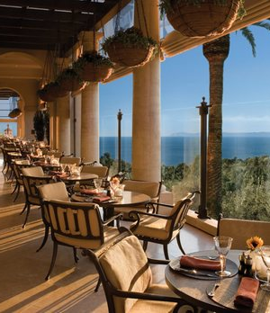
WHAT’s YELP?
WHY YELP?
Yelp is a “crowd-sourced local business review and social networking site”.
This company offers a vast amount of data that is open to the public for academic use.
Notes:
[Sara]
Yelp is a site that provides local business reviews made by Yelp users, known as “Yelpers”... Yelpers can grow their community by adding friends and joining the “Yelp Elite Squad” if they are an active user… so Yelp can be considered a “business review and social networking site”...
So why did we choose Yelp? *click* We chose Yelp because this company offer a large amount of data, and Yelp is also a company that has been around for a while but still has room for growth, which was perfect for this project.

Slide 5

METADATA
(ENTITIES)
Businesses
Contains business data including location, attributes, and categories
Reviews
Contains the full review text data including the user id and business id
USERS
Contains user data including the user’s friend mapping
CHECK INS
Contains the business id and list of check-ins
TIPS
Contains all tips or suggestions written by a user on a business
Notes:
[Sara]
So, just a quick overview of the entities… The Yelp data set comes with these 5 tables. *click* The ‘business’ table contains all the business data, from location to business attributes and categories. *click*
The ‘reviews’ table has all the reviews, including the id of the user who wrote the review and the id of the business that the review was written for. *click*
The ‘users’ table contains all the data from the user profiles, including the ids of its friends. *click*
The ‘check ins’ table is a small 2-column table that has the business id and a list of check-in timestamps. *click*
And lastly, the ‘tips’ table is a way for users to pass on short, key information about a business (for example, the best time to visit or a favorite dish).

Slide 6
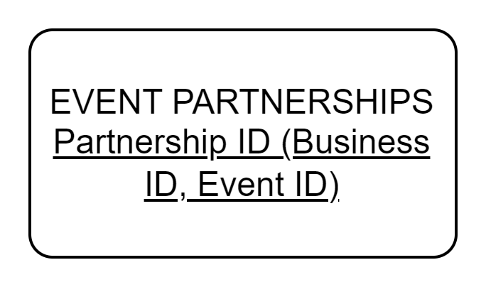
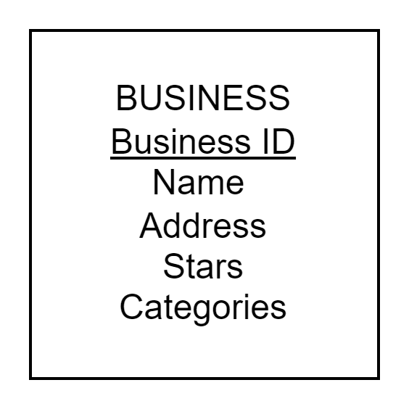
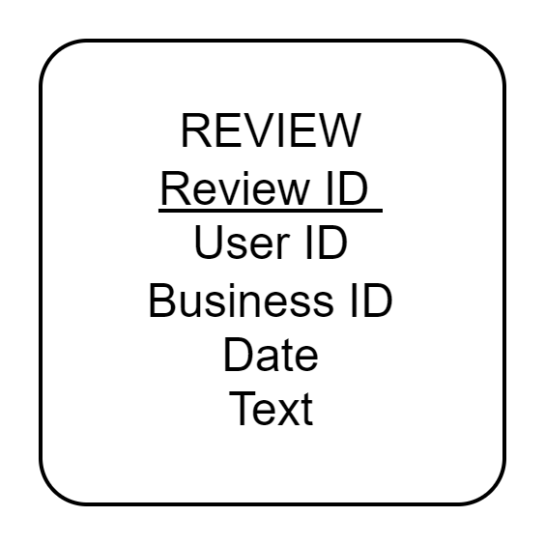
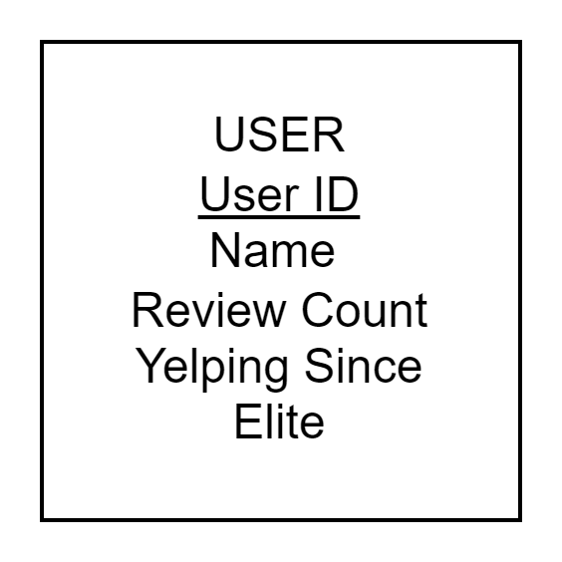
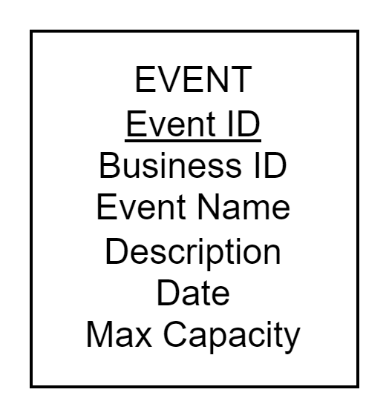
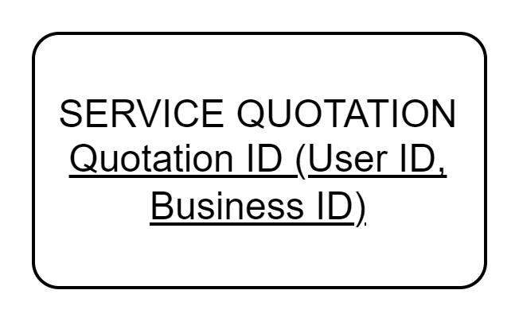

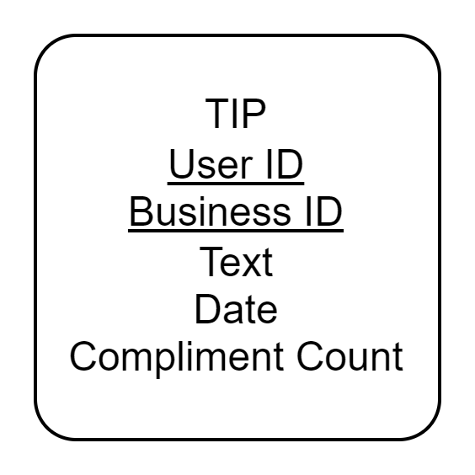
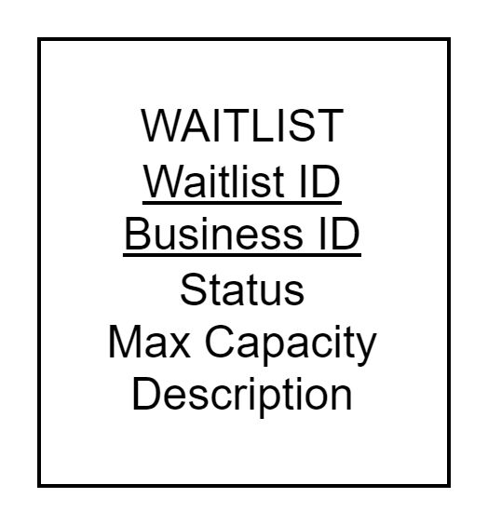
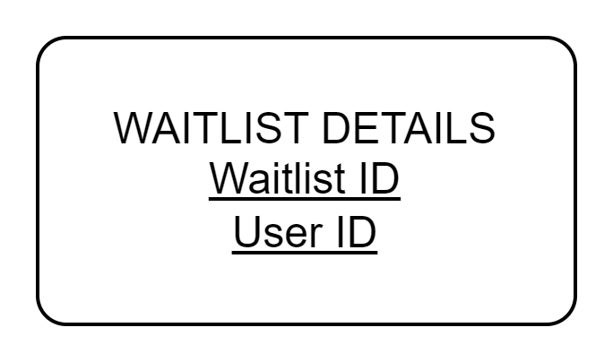
METADATA (ATTRIBUTES)
original entities
new entities
Notes:
[Sara]
So, here we’ll be going into more detail about the metadata for the some of the attributes… *click* Please note that each table has one or more attributes that uniquely identifies the table or is needed to link the other tables… for example, business id, user id, and review id… and each of these attributes are a unique 22-character string… So in this `business` entity, there’s a total of 14 attributes but these are just some of the important ones… Id as mentioned earlier, Name which is the name of the business and Address is the street address of the business, for example 123 Main Street…. Stars is the star ratings of the business and it has a float data type.. The minimum value for Stars is 0 and the maximum is 5…and Categories is a list of all groups the business falls under… for example, American, Seafood, and Bar *click*
The `review` entity is an associate entity in that it links the business and user tables… Some of the important attributes in this entity is “date” which is the date the review was written, “text” which is the text of the review… which I believe has a maximum of 5-thousand characters… “stars” is the number of stars the user gives the business, which is a float data type.. *click*
In the `users` entity, the important attributes are “name” or the name of the user, “review count” which is the number of reviews the user has written… therefore, it’s a positive integer value… “yelping since” is the date when the user joined Yelp, and “elite”, an optional attribute that contains a string of years the member was an elite member. *click*
The `check-in` entity can be considered a weak entity because when the business record is removed from the business entity… the check ins for that business does not need to be stored. This entity is a small entity in that it only has two attributes - the business ID that links the record to the business entity and “date”, a comma-separated list of timestamps of check ins... *click*
And lastly, the `tip` entity is an associate entity because it links the user and business entities. The “text” is the written part of the tip. The “date” is the date when the tip was written… and the “compliment count” is a positive integer value of the number of people that found the tip useful or interesting.
So, moving onto the new entities that we created *click* .. The first one is an “event” entity… one of the ways that Yelp could expand its business is by allowing businesses to host events and allowing Yelpers to purchase tickets or RSVP to those events...The data could be stored in an “event” entity which would store the name, description, and date of the event… as well as the number of of maximum attendees. *click*
Another new entity that we created is a “waitlist” entity… the waitlist functionality for businesses already exists on Yelp... However, Yelp does not seem to be storing that information.. If Yelp were to store waitlist data, such as the “status” of waitlist like open, close, full, etc…, the max capacity… and description of the waitlist… perhaps Yelp could help businesses better manage its reservations.. *click*
We also created a “service quotation” entity… because some of the businesses on Yelp are service businesses. This entity could store the quote details, like cost, service type, and date of inquiry…By storing this data, Yelp could potentially expand the service business side of its business by making service requests more streamlined… from requesting a quote, to scheduling an appointment and making a transaction… This could be considered an associative entity… because it links the business and users entities… *click**click* And the last two entities are other associative entities that link the “event” and “waitlist” entities to the existing data model.

Slide 7
02
RELATIONSHIPS, BUSINESS Rules,
ERD
Notes:
[Sara]
Now I will be passing it on to Angel to discuss the relationships, business rules, and ERD.

Slide 8

Business rules
Users can join a waitlist for a business only if the business is indicated as 'open'.
Eligibility for 'elite' status requires users to meet a minimum review threshold and maintain high engagement (useful, funny, cool votes) annually.
Only registered users with a unique identifier (UserID) are permitted to post reviews or tips.
A verified email address is mandatory for users to publish reviews or tips on Yelp.
users
Each business listed on the platform must provide a valid address, which includes the city, state, and postal code.
A business may accumulate numerous reviews, tips, and check-ins, but each review, tip, or check-in must correspond to one unique business.
business
Notes:
Thanks Sara, Next, here’s an overview of Yelp business rules.
For Users:
• Waitlists are open only for active businesses.
• 'Elite' status requires a yearly minimum of reviews and high community interaction.
• Users must have a Yelp account to create reviews or tips.
• Posting content requires a verified email.
(click)For Businesses:
• Listings need a full address to appear on Yelp.
• Businesses are uniquely linked to their reviews, tips, and check-ins.

Slide 9
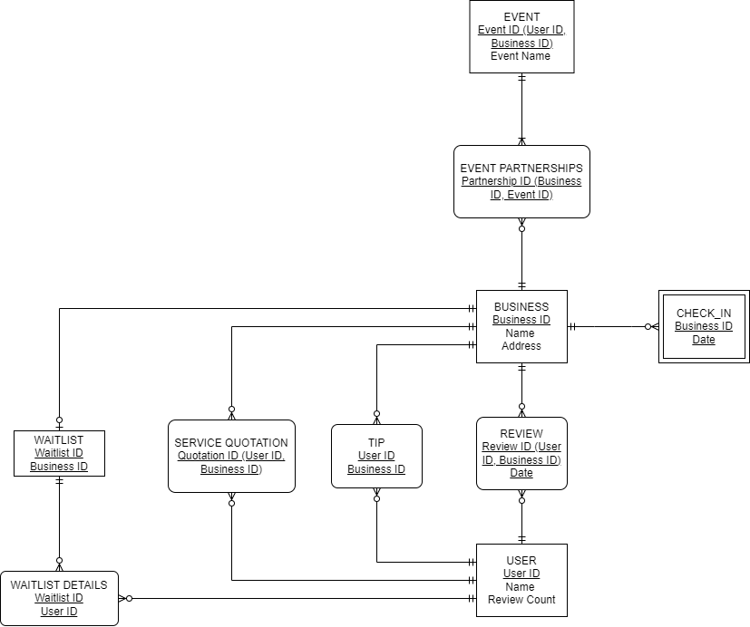
ER DIAGRAM
Legend
 | Original
 | New
Notes:
Let’s dive in the ER diagram, we break it into three parts:
(click)
Users:
• Each User ID may have multiple Reviews and Tips, all tied to single businesses.
• Users can be on various Waitlists, each linked to one business waitlist.
(click*2)
Businesses:
• Central to the model, Businesses connect to many Reviews, Tips, and Check-Ins.
• Businesses can participate in numerous Event Partnerships, each unique to one Event.
(click*2)
Associated Entities:
The "Waitlist" entity connects to the "Business" entity, where each Business can have its waitlist for users to join. The "Service Quotation" entity also displays a one-to-many relationship with Business, indicating that a Business can have multiple quotes associated with it.
Lastly, the "Event" entity forms a one-to-many relationship with "Event Partnerships," signifying that while an Event may collaborate with several Businesses, each partnership is specific to one Business and one Event.
This entity-relationship diagram (ERD) illustrates the crucial relationships that are integral to Yelp platform.

Slide 10
03
Relational
Data modeling,
As-is dependencies
Notes:
Now it's Lisa's turn to discuss Relational Data modeling and As-is dependencies.

Slide 11
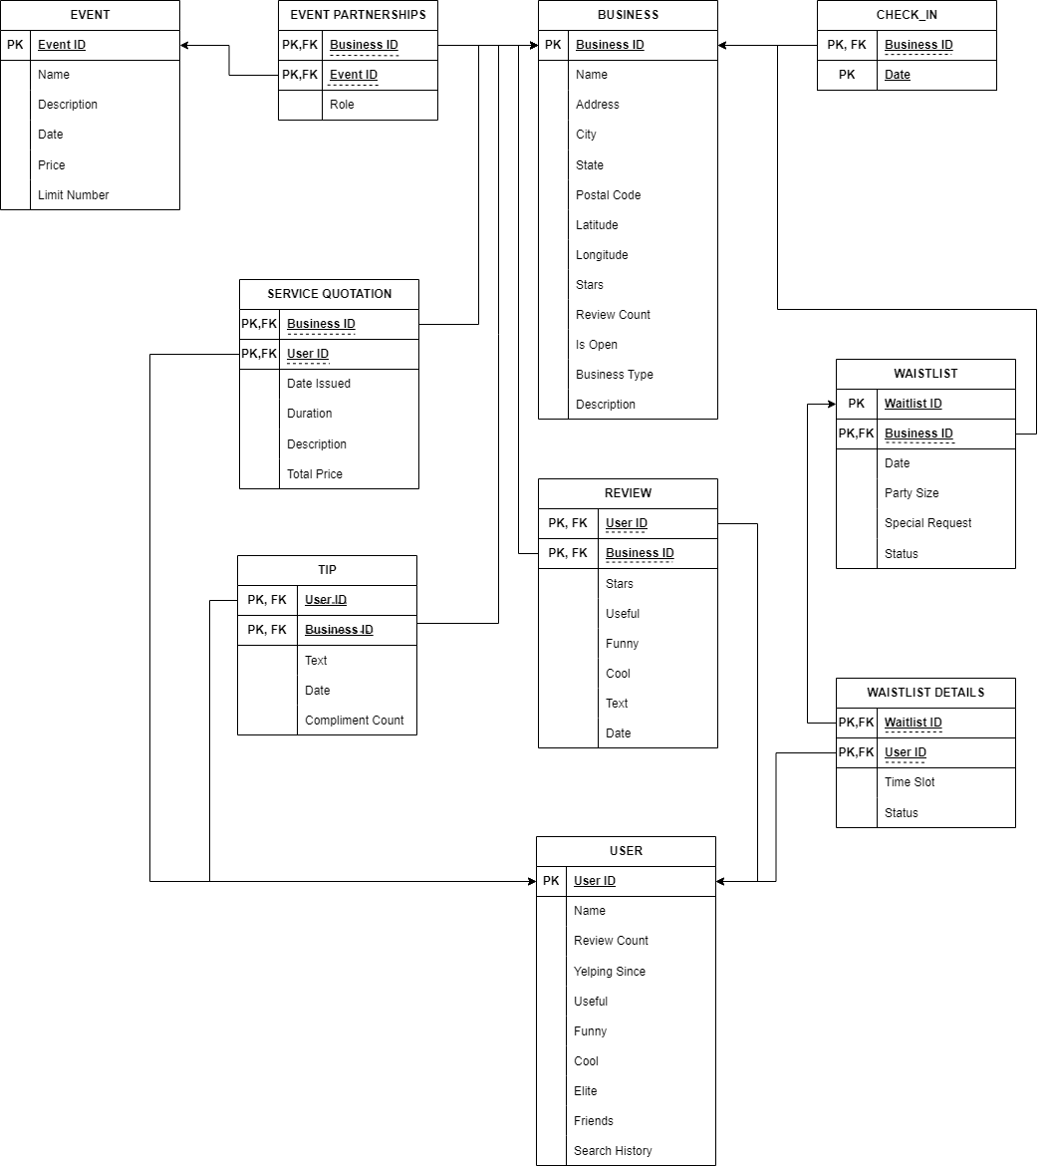
Relational data modeling

Slide 12
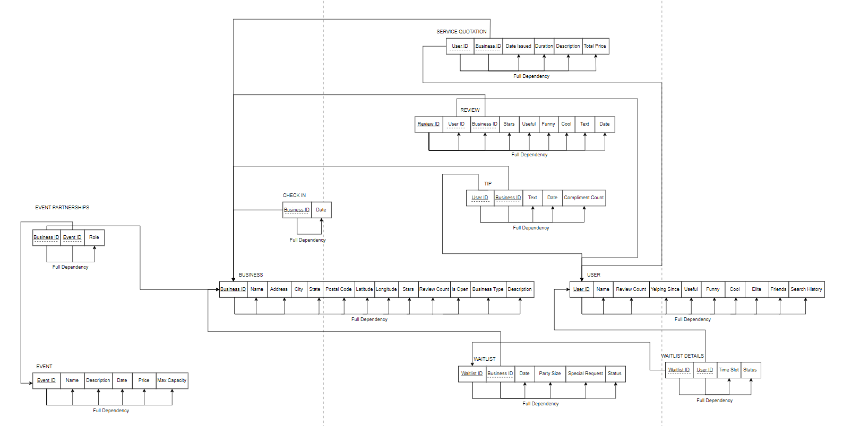
As - Is Dependencies

Slide 13
04
Normalization
(3rd normal form)

Slide 14
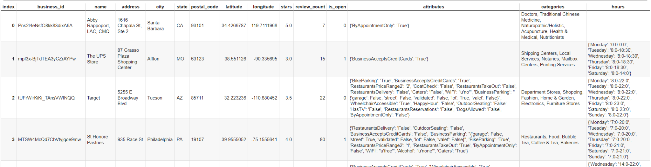
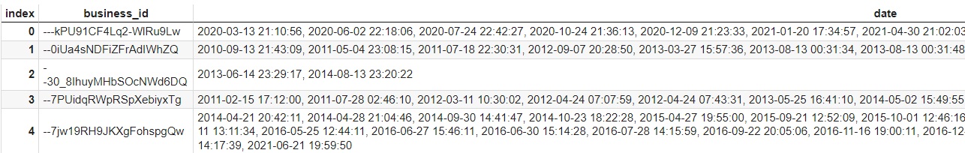
All Tables in 3rd Normal Form!
Business Entity table
Check-in Entity table

Slide 15
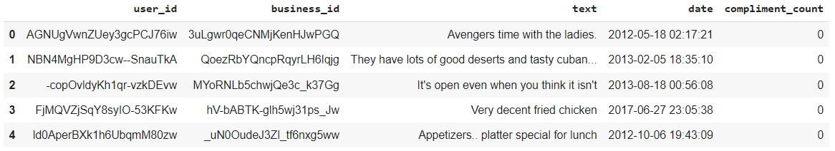
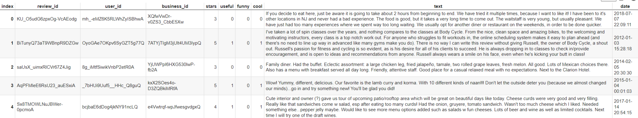
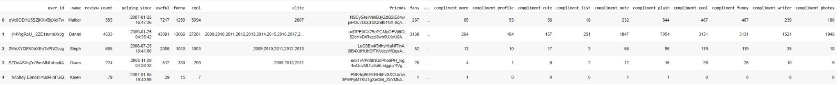
All Tables in 3rd Normal Form!
Review Entity table
Tips Entity table
User Entity table

Slide 16
05
SQL Queries,
Data Analysis,
Findings

Slide 17

Business
Questions
1. Which types of businesses are most frequently reviewed by users with a high review count (>600), what are their average star ratings?
2.Who are the elite users? How many reviews do they have?
3.What are the top three businesses that have received the most reviews from users with a large fan base(>=100) on the platform?
4.What business locations have the highest check-in frequency?
5.What kind of business category are the top 5 check-in?
6.Do businesses with higher review counts tend to receive more tips?

Slide 18
1. Which types of businesses are most frequently reviewed by users with a high review count (>600), what are their average star ratings?
SELECT B.categories, AVG(R.stars) AS average_star_rating
FROM User U
INNER JOIN Review R ON U.User_id = R.User_id
INNER JOIN yelp_academic_dataset_business B ON R.Business_id = B.Business_id
WHERE U.Review_count > 600
GROUP BY B.categories
ORDER BY average_star_rating DESC;
2.Who are the elite users? How many reviews do they have?
3.What are the top three businesses that have received the most reviews from users with a large fan base(>=100) on the platform?
4.What business locations have the highest check-in frequency?
5.What kind of business category are the top 5 check-in?
6.Do businesses with higher review counts tend to receive more tips?
Notes:
which business categories are popular among the most active reviewers and their satisfaction level.
If active reviewers tend to frequently review certain types of businesses, it might show a trend or preference within a well-engaged customer segment.
Understanding this can help businesses within those categories to tailor their marketing strategies to attract such active reviewers.
The average star rating could be a benchmark for other businesses. A high average star rate from active users could indicate a superior service or product offerings compared to others.
Businesses could identify these active users as influencers and engage with them for marketing purposes → Influencer marketing campaign

Slide 19
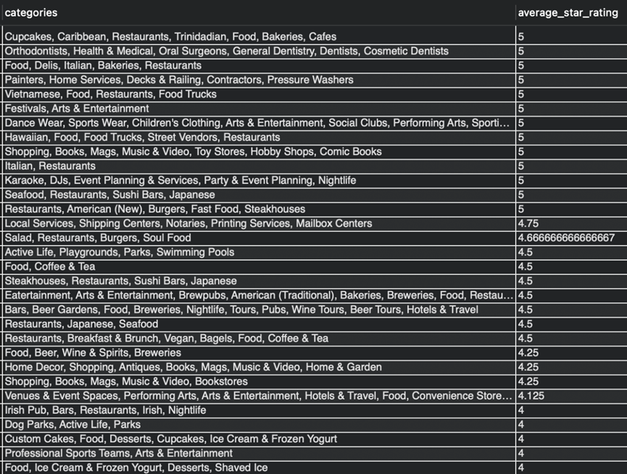
1. Which types of businesses are most frequently reviewed by users with a high review count (>600), what are their average star ratings?
2.Who are the elite users? How many reviews do they have?
3.What are the top three businesses that have received the most reviews from users with a large fan base(>=100) on the platform?
4.What business locations have the highest check-in frequency?
Businesses with perfect ratings often specialize in a specific niche
Focusing on high-quality service leads to excellent reviews
5.What kind of business category are the top 5 check-in?
6.Do businesses with higher review counts tend to receive more tips?
Notes:
which business categories are popular among the most active reviewers and their satisfaction level.
If active reviewers tend to frequently review certain types of businesses, it might show a trend or preference within a well-engaged customer segment.
Understanding this can help businesses within those categories to tailor their marketing strategies to attract such active reviewers.
The average star rating could be a benchmark for other businesses. A high average star rate from active users could indicate a superior service or product offerings compared to others.
Businesses could identify these active users as influencers and engage with them for marketing purposes → Influencer marketing campaign

Slide 20
SELECT u.user_id, u.name, u.review_count, date_joined.joined as joined, u.useful, u.funny, u.cool, u.fans, round(avg(stars),1) as avg_stars
FROM user u
INNER JOIN (
SELECT user_id, str_to_date(yelping_since, '%m/%d/%Y') as joined
FROM user
WHERE elite <> ""
) as date_joined
ON u.user_id = date_joined.user_id
INNER JOIN review r ON u.user_id = r.user_id
GROUP BY u.user_id, u.name, u.review_count, date_joined.joined, u.useful, u.funny, u.cool, u.fans
ORDER BY review_count desc;
1. Which types of businesses are most frequently reviewed by users with a high review count (>600), what are their average star ratings?
2.Who are the elite users? How many reviews do they have?
3.What are the top three businesses that have received the most reviews from users with a large fan base(>=100) on the platform?
4.What business locations have the highest check-in frequency?
5.What kind of business category are the top 5 check-in?
6.Do businesses with higher review counts tend to receive more tips?
Notes:
Why is this important to know:
Elite Yelpers are users who are actively supporting local businesses and sharing positive, helpful contributions on Yelp. Therefore, they are an important and influential group in the Yelp community. Having a better understanding of who these members are could allow the business to grow its social network.

Slide 21
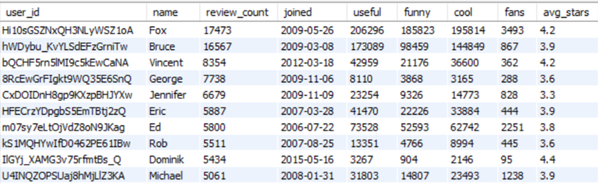
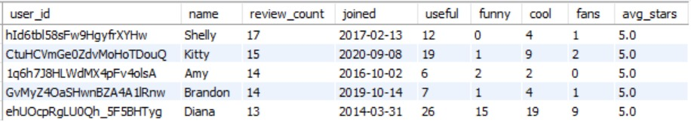
1. Which types of businesses are most frequently reviewed by users with a high review count (>600), what are their average star ratings?
2.Who are the elite users? How many reviews do they have?
3.What are the top three businesses that have received the most reviews from users with a large fan base(>=100) on the platform?
4.What business locations have the highest check-in frequency?
Some elite users, with a presence on the site for over 10 years, boast a large number of reviews and receive numerous "reactions" (useful, funny, cool).
Other elite users, have a limited number of reviews, yet consistently give 5-star ratings.
5.What kind of business category are the top 5 check-in?
6.Do businesses with higher review counts tend to receive more tips?
Notes:
Why is this important to know:
Elite Yelpers are users who are actively supporting local businesses and sharing positive, helpful contributions on Yelp. Therefore, they are an important and influential group in the Yelp community. Having a better understanding of who these members are could allow the business to grow its social network.

Slide 22
1. Which types of businesses are most frequently reviewed by users with a high review count (>600), what are their average star ratings?
SELECT b.business_id, b.name as business_name, count(*) as Amount_Of_Popular_Users, sum(b.review_count) as Total_Review
FROM user as u
RIGHT JOIN review r ON u.user_id = r.user_id
JOIN business b ON b.business_id = r.business_id
WHERE fans >= 100
GROUP BY b.business_id, b.name
ORDER BY Total_Review DESC
LIMIT 3;
2.Who are the elite users? How many reviews do they have?
3.What are the top three businesses that have received the most reviews from users with a large fan base(>=100) on the platform?
4.What business locations have the highest check-in frequency?
5.What kind of business category are the top 5 check-in?
6.Do businesses with higher review counts tend to receive more tips?
Notes:
Identifying businesses that engage with popular users provides insights into community dynamics and preferences. This knowledge helps both platforms and businesses to tailor their strategies, aligning them with user interests.

Slide 23
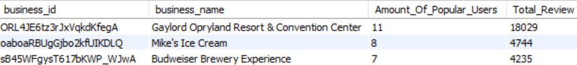
1. Which types of businesses are most frequently reviewed by users with a high review count (>600), what are their average star ratings?
2.Who are the elite users? How many reviews do they have?
3.What are the top three businesses that have received the most reviews from users with a large fan base(>=100) on the platform?
Identifying businesses that engage with popular users
Provides insights into community dynamics and preferences
4.What business locations have the highest check-in frequency?
5.What kind of business category are the top 5 check-in?
6.Do businesses with higher review counts tend to receive more tips?
Notes:
Identifying businesses that engage with popular users provides insights into community dynamics and preferences. This knowledge helps both platforms and businesses to tailor their strategies, aligning them with user interests.

Slide 24
1. Which types of businesses are most frequently reviewed by users with a high review count (>600), what are their average star ratings?
2.Who are the elite users? How many reviews do they have?
SELECT postal_code, sum(date_count) as sum_checkin
FROM business b
INNER JOIN checkin c
ON b.business_id = c.business_id
GROUP BY postal_code
ORDER BY sum_checkin desc
LIMIT 5;
3.What are the top three businesses that have received the most reviews from users with a large fan base(>=100) on the platform?
4.What business locations have the highest check-in frequency?
5.What kind of business category are the top 5 check-in?
6.Do businesses with higher review counts tend to receive more tips?
Notes:
Frequent check-ins in Santa Barbara to Reno show the universal appeal of cultural and recreational spots. People prefer vibrant, activity-rich environments found in urban and suburban areas. These locations attract both locals and tourists, offering a mix of cultural richness and recreational activities.

Slide 25
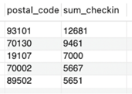
1. Which types of businesses are most frequently reviewed by users with a high review count (>600), what are their average star ratings?
93101 - Santa Barbara, California
70130 - New Orleans, Louisiana
19107 - Philadelphia, Pennsylvania
70002 - Metairie, Louisiana
89502 - Reno, Nevada
2.Who are the elite users? How many reviews do they have?
3.What are the top three businesses that have received the most reviews from users with a large fan base(>=100) on the platform?
4.What business locations have the highest check-in frequency?
Frequent check-ins from Santa Barbara to Reno highlight the universal appeal of cultural and recreational spots
Preference for vibrant, activity-rich environments in both urban and suburban areas
5.What kind of business category are the top 5 check-in?
6.Do businesses with higher review counts tend to receive more tips?
Notes:
Frequent check-ins in Santa Barbara to Reno show the universal appeal of cultural and recreational spots. People prefer vibrant, activity-rich environments found in urban and suburban areas. These locations attract both locals and tourists, offering a mix of cultural richness and recreational activities.

Slide 26
1. Which types of businesses are most frequently reviewed by users with a high review count (>600), what are their average star ratings?
2.Who are the elite users? How many reviews do they have?
SELECT categories,sum(date_count) as sum_checkin
FROM business b
INNER JOIN checkin c
GROUP BY categories
ORDER BY sum_checkin desc
LIMIT 5;
3.What are the top three businesses that have received the most reviews from users with a large fan base(>=100) on the platform?
4.What business locations have the highest check-in frequency?
5.What kind of business category are the top 5 check-in?
6.Do businesses with higher review counts tend to receive more tips?
Notes:
Marketing Insights: Analyzing check-in patterns can reveal valuable insights for targeted marketing campaigns, promotions, and special offers. Businesses can better allocate their marketing budgets by understanding which locations and types of businesses attract more check-ins, resulting in better ROI.
Strategic Planning: Strategic decision-making for resource allocation, marketing budget planning, and promotional activities can be enhanced by identifying trends in check-ins across different locations and business categories, which can in turn improve customer engagement and business visibility.

Slide 27
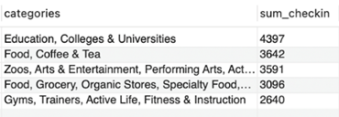
1. Which types of businesses are most frequently reviewed by users with a high review count (>600), what are their average star ratings?
2.Who are the elite users? How many reviews do they have?
3.What are the top three businesses that have received the most reviews from users with a large fan base(>=100) on the platform?
Rising consumer interest in educational, social, and health-focused experiences.
Businesses in these sectors can leverage this trend by providing enriching experiences to their customers.
4.What business locations have the highest check-in frequency?
5.What kind of business category are the top 5 check-in?
6.Do businesses with higher review counts tend to receive more tips?
Notes:
Marketing Insights: Analyzing check-in patterns can reveal valuable insights for targeted marketing campaigns, promotions, and special offers. Businesses can better allocate their marketing budgets by understanding which locations and types of businesses attract more check-ins, resulting in better ROI.
Strategic Planning: Strategic decision-making for resource allocation, marketing budget planning, and promotional activities can be enhanced by identifying trends in check-ins across different locations and business categories, which can in turn improve customer engagement and business visibility.

Slide 28
1. Which types of businesses are most frequently reviewed by users with a high review count (>600), what are their average star ratings?
2.Who are the elite users? How many reviews do they have?
SELECT name, review_count, tips_count
FROM business_data
JOIN tips_data
ON business_data.business_id = tips_data.business_id
ORDER BY tips_count DESC;
3.What are the top three businesses that have received the most reviews from users with a large fan base(>=100) on the platform?
4.What business locations have the highest check-in frequency?
5.What kind of business category are the top 5 check-in?
6.Do businesses with higher review counts tend to receive more tips?
Notes:
It is not always that businesses that have a higher review count tend to receive higher tips.
Tips are given purely by reviewers for informing new visitors about something special about the business.
We can see that some businesses that have extremely high review counts, don’t necessarily have the highest tips.
This can be because, the business is already famous and there aren’t any special comments to make.
Yelp can promote business that have a good balance between reviews and tips counts and identify them as potential successful businesses.

Slide 29
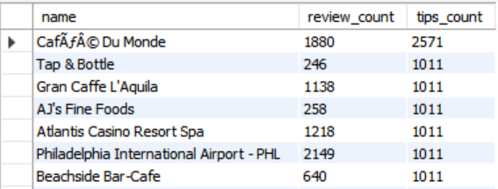
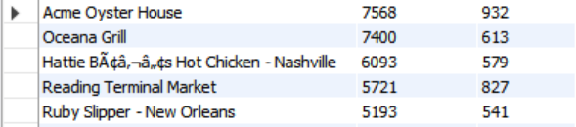
1. Which types of businesses are most frequently reviewed by users with a high review count (>600), what are their average star ratings?
2.Who are the elite users? How many reviews do they have?
3.What are the top three businesses that have received the most reviews from users with a large fan base(>=100) on the platform?
4.What business locations have the highest check-in frequency?
It is not always that businesses that have a higher review count tend to receive higher tips.
Tips are given purely by reviewers for informing new visitors about something special about the business.
This may happen if the business is famous, reducing the need for unique comments.
5.What kind of business category are the top 5 check-in?
6.Do businesses with higher review counts tend to receive more tips?
Notes:
It is not always that businesses that have a higher review count tend to receive higher tips.
Tips are given purely by reviewers for informing new visitors about something special about the business.
We can see that some businesses that have extremely high review counts, don’t necessarily have the highest tips.
This can be because, the business is already famous and there aren’t any special comments to make.
Yelp can promote business that have a good balance between reviews and tips counts and identify them as potential successful businesses.

Slide 30
06
PROJECT
EXTENSION

Slide 31

We've discovered intriguing Yelp services like waitlist and service quotes and aim to explore these further for deeper business insights.

Slide 32

memberS’ contribution
 | Sara | angel | lisa | ting | molly
Stage 1 | Create a metadata document | Create two more entities and five attributes for each. | Draw an ER Diagram | Define specific business rules | Create 5 business questions
Stage 2 | as-is dependency diagram | as-is dependency diagram | Graphical relational schema and as-is dependency diagram | as-is dependency diagram | as-is dependency diagram
Stage 3 | Data Analysis using SQL | Data Analysis using SQL | Data Analysis using SQL | Data Analysis using SQL | Data Analysis using SQL

Slide 33
Thank you for listening

